Slide 1
RTB - IMI
Apr 2022

Slide 2
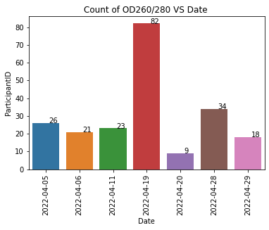
BIO Resource
 | OD 260/280 | OD 260/230 | Concentration
Blood | 1.75 - 2.04 | >1.5 | > 30ng/ul

Slide 3
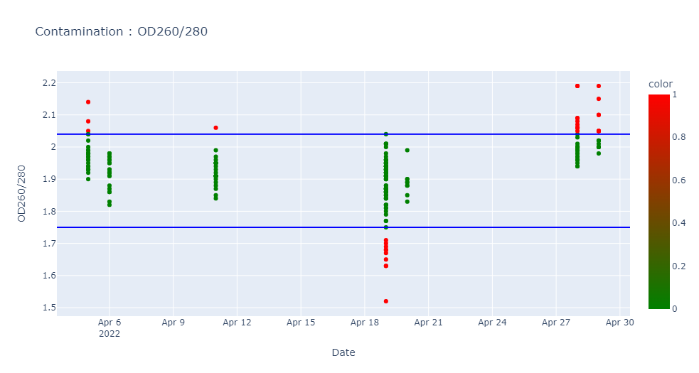
Contamination : OD260/280 (1.75 – 2.04)
ParticipantID | Date | OD260/280 | OD260/230 | Concentration
L000289N | 05/04/2022 | 2.14 | 2.3 | 56.38
L003145S | 05/04/2022 | 2.08 | 2.31 | 63.04
L002435W | 05/04/2022 | 2.05 | 2.52 | 101.74
L004316Q | 11/04/2022 | 2.06 | 2.49 | 52.58
L000792K | 19/04/2022 | 1.63 | 0.94 | 176.59
L004230X | 19/04/2022 | 1.52 | 0.94 | 216.95
L003487P | 19/04/2022 | 1.68 | 1.03 | 66.93
L003490S | 19/04/2022 | 1.7 | 1.4 | 158.13
L004236D | 19/04/2022 | 1.69 | 1.29 | 138.24
L002282E | 19/04/2022 | 1.71 | 1.03 | 149.07
L004240H | 19/04/2022 | 1.65 | 1.08 | 153.75
L003102W | 19/04/2022 | 1.63 | 0.84 | 123.33
L004021V | 19/04/2022 | 1.68 | 1.19 | 83.34
L002895W | 19/04/2022 | 1.67 | 1.04 | 115.85
L004858E | 28/04/2022 | 2.07 | 2.24 | 85.28
L003557Q | 28/04/2022 | 2.06 | 2.24 | 79.48
L004745G | 28/04/2022 | 2.19 | 2.15 | 52.04
L000736Z | 28/04/2022 | 2.19 | 2.26 | 57.89
L003994Q | 28/04/2022 | 2.09 | 2.35 | 79.04
L002916T | 28/04/2022 | 2.06 | 1.62 | 62.89
L004829Y | 28/04/2022 | 2.08 | 2.29 | 68.38
L003888A | 28/04/2022 | 2.09 | 1.82 | 126.33
L000311M | 28/04/2022 | 2.06 | 2.31 | 122.82
L004692Z | 28/04/2022 | 2.05 | 2.24 | 67.91
L004860G | 29/04/2022 | 2.1 | 2.08 | 72.75
L002858F | 29/04/2022 | 2.05 | 2.62 | 111.44
L005115J | 29/04/2022 | 2.19 | 2.82 | 78.4
L004228V | 29/04/2022 | 2.15 | 2.08 | 58.3
L005114H | 29/04/2022 | 2.05 | 2.55 | 131.98
L002785B | 29/04/2022 | 2.05 | 2.4 | 121.04
L001600N | 29/04/2022 | 2.1 | 2.51 | 69.69
L004604D | 29/04/2022 | 2.05 | 2.39 | 111.96
L004828X | 29/04/2022 | 2.05 | 2.13 | 125.06

Slide 4
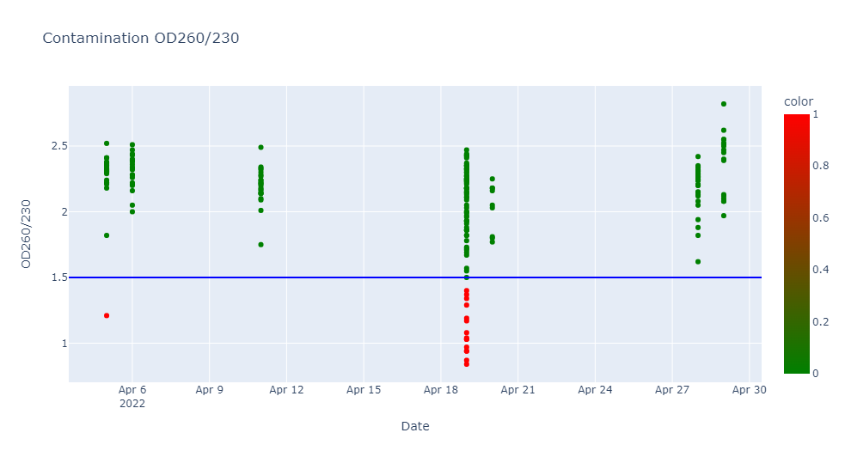
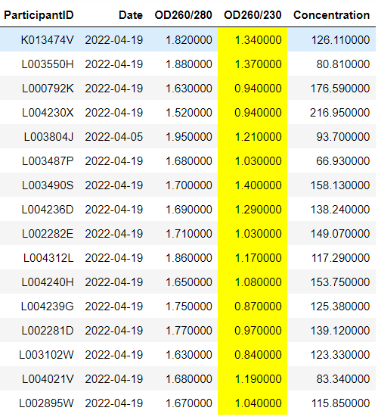
Contamination : OD260/230 (>1.5)

Slide 5
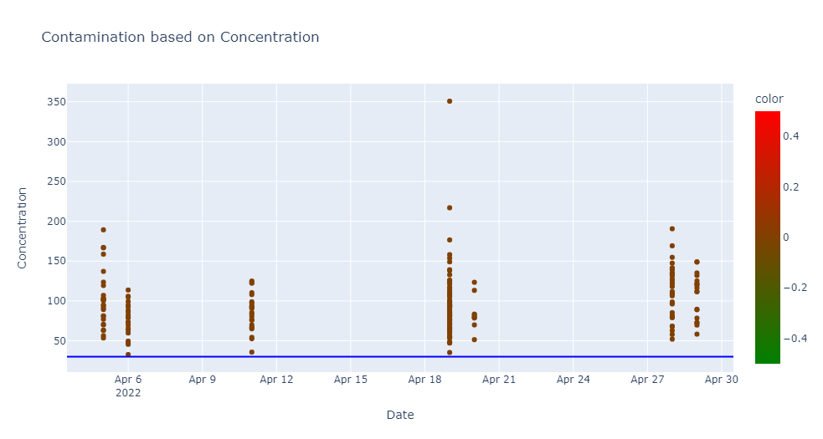
Contamination : Concentration (> 30 ng/ul)
There is NO contamination in the concentration. (ie) All the samples have > 30 ng/ul concentration.

